Slide 1
INTRODUCTION

Slide 2
WHAT DOES IT MEAN BY
ENVIRONMENTAL ETHICS?

Slide 3
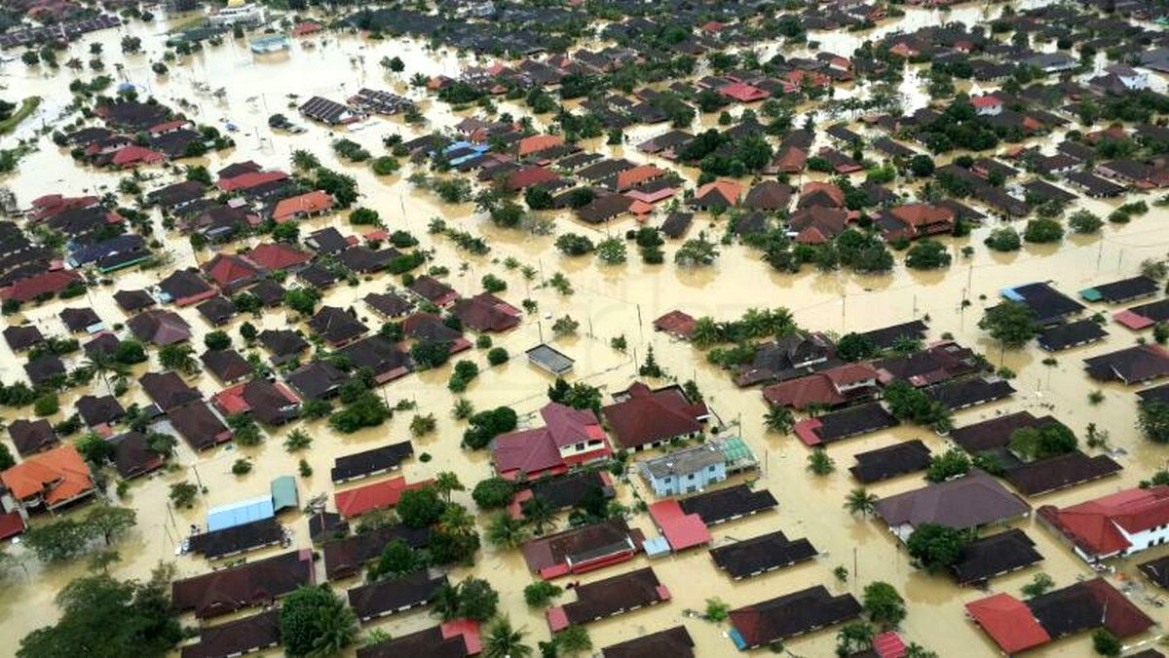
JAKARTA FLOOD 2013

Slide 4
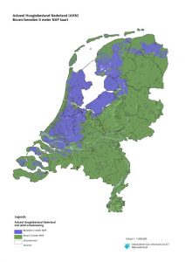
HOLLAND?

Slide 5
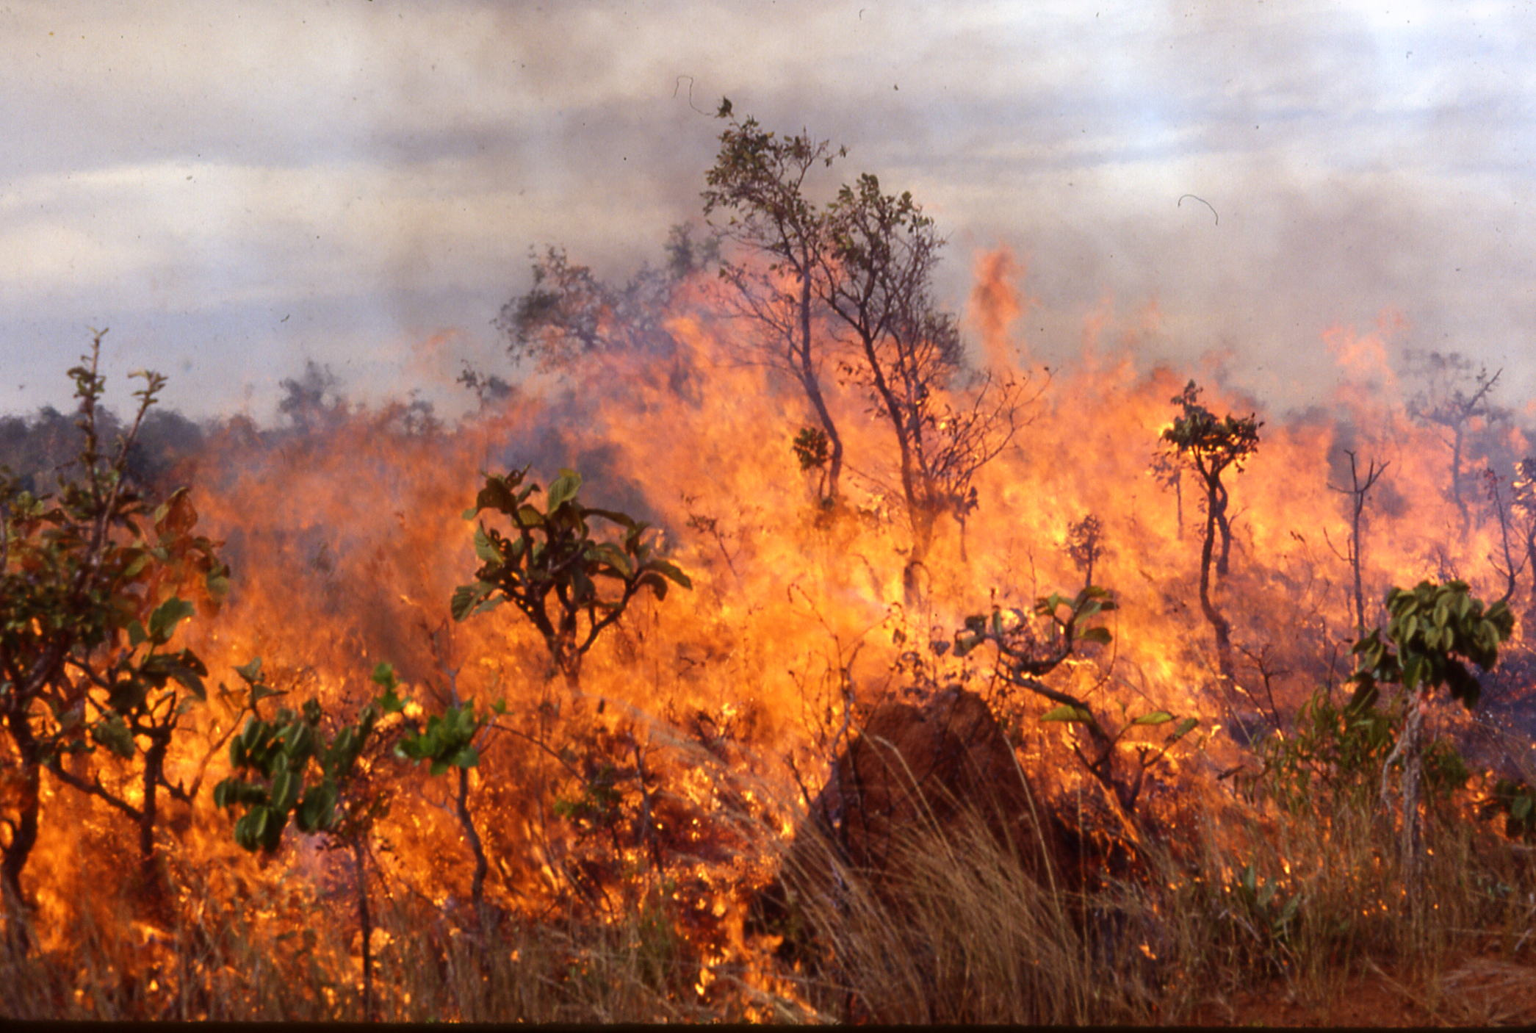
SLASH AND BURN TECHNOLOGY
is a farming method that involves the cutting andburning of plants in a forest or woodland to create a field called a swidden

